Slide 1
An introduction to romanticism
Lingua e cultura inglese I (LT) – A.A. 2019/2020
Marco Canani, Ph.D. – m.canani@univda.it
Fall Term

Slide 2
What google says…

Slide 3
On ‘romanticism’
1920s: Arthur O. Lovejoy
The word ‘romantic’ has come to mean so many things that, by itself, it means nothing. It has ceased to perform the function of a verbal sign. […] we should learn to use the word ‘Romanticism’ in the plural. This, of course, is already the practise of the more cautious and observant literary historians […].
Andrew Sanders, The Short Oxford History of English Literature
The period 1780-1830 is more open to conflicting interpretation than most others. […] It was an age of ‘Romanticism’, but the complex definition of Romanticism or of ‘Romanticisms’, could be variously ignored, challenged, … debated, or simply questioned by writers who were not swimming against a contemporary tide. A variety of ways of writing, thinking about, criticizing and defining literature co-exist in any given age, but in this particular period the varities are especially diverse and the distinctions notably sharp.

Slide 4
BACK THEN…
1790s in Germany, August and Friedrich Schlegel: romantische Poesie → “romantic poetry” as opposed to "classical poetry” (different spirit)
1820, Lord Byron: “I perceive that in Germany, as well as in Italy, there is a great struggle about what they call ‘Classical’ and ‘Romantic,’ terms which were not subjects of classification in England, at least when I left it four or five years ago”.
Lake School (‘Lake Poets’: William Wordsworth, Samuel Taylor Coleridge, Robert Southey)
Cockney School (Leigh Huny, John Keats, Percy Bysshe Shelley)
Satanic School (Lord Byron, Percy Bysshe Shelley)

Slide 5
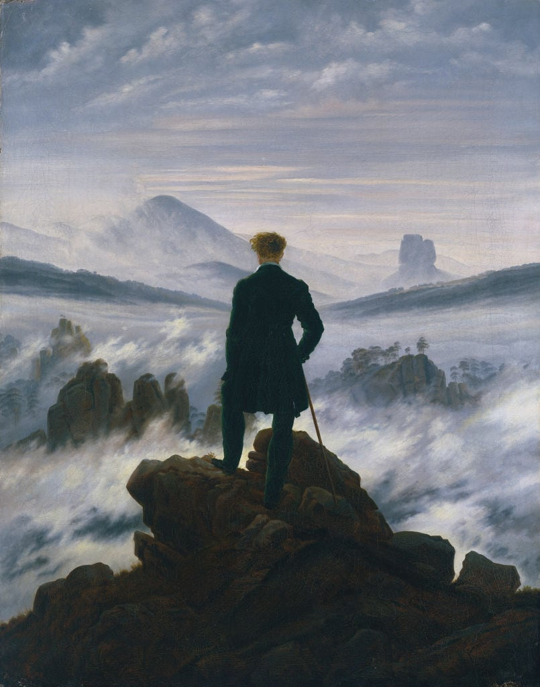
What do we (usually) mean by ‘romanticism’ ?
Romanticism: an artistic and intellectual ‘mindset’ taking place in Europe between the late eighteenth and mid-nineteenth centuries.
Pioneering – almost revolutionary. Romanticism involved breaking with the past, and consciously moving away from the ideas and traditions of the Enlightenment.
Romanticism changed the prevailing attitudes toward nature, emotion, reason and even the individual.
As a break from the Enlightenment, Romantic culture emphasized emotional sensitivity and individual subjectivity.
imagination as the most important creative faculty.
https://www.nationaltrust.org.uk/features/what-is-romanticism
Caspar David Friedrich, Wanderer above the Sea of Fog (1818)

Slide 6
A change…
Romanticism as opposed to Neoclassicism
Neoclassicism attempted to revive the artistic ideals of classical Greece and Rome.
Neoclassicism was characterized by order, logic, technical precision, balance, elegance of diction, decorum.
Cuddon, J.A. The Penguin Dictionary of Literary Terms and Literary Theory. Third Ed. London: Penguin Books, 1991.

Slide 7
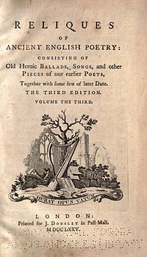
ddd

Slide 8
WILLIAM WORDSWORTH (1770-1850)
Born in Cumberland (“Lake District”)
1790: walking tour of France and the Alps
Interested in the democratic ideals of Revolutionary France.
Reign of Terror and war between England and France → back to England.
1797-1799: he collaborates with Coleridge → Lyrical Ballads
Back to the Lake District with his sister Dorothy:
1799-1808 “Dove Cottage” (Grasmere)
1813: “Rydal Mount” (Ambleside)
1843 Poet Laureate

Slide 9
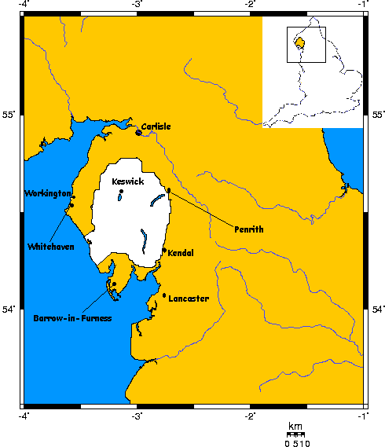
WORDSWORTH and nature
usually celebrated as “the poet of nature” even though his poetry does not offer so many descriptions of nature
‘Preface’ to Lyrical Ballads
man and nature
values in nature → Rousseau
man can learn from nature

Slide 10
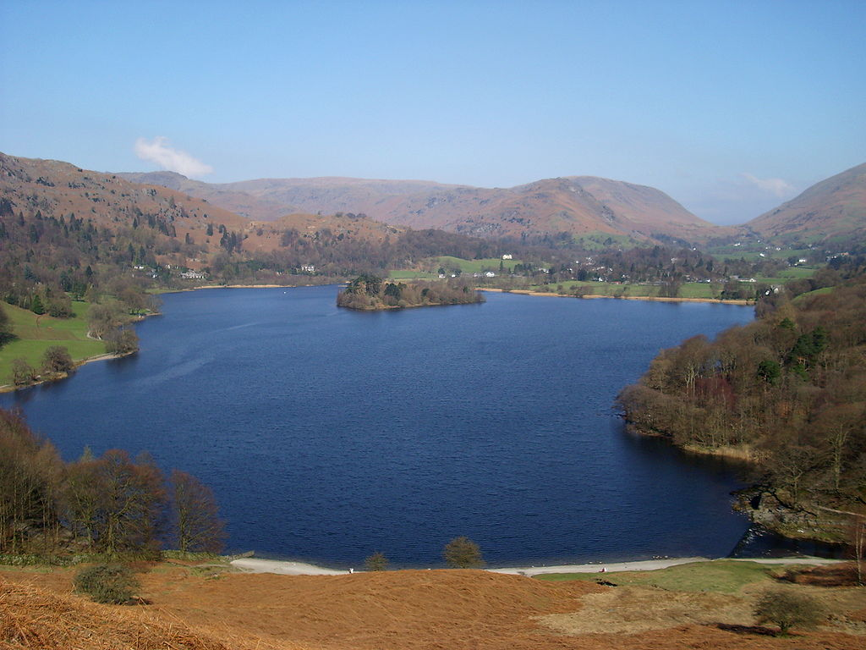
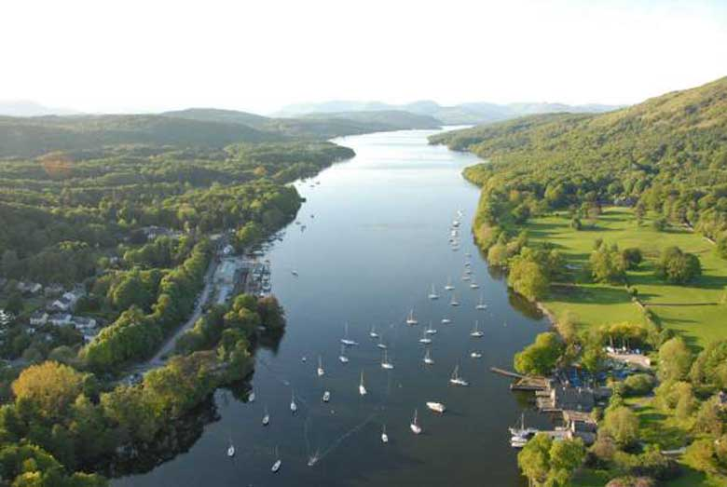
GRASMERE LAKE
WINDERMERE LAKE

Slide 11
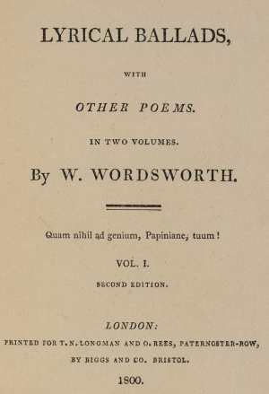
LYRICAL BALLADS
Title! → ?
Collection of poems by William Wordsworth and Samuel Taylor Coleridge
1799 (anonymously)
1800 – 1802
The second edition included a preface by Wordsworth
Wordsworth’s ideas on poetry
The ‘manifesto’ of English Romanticism

Slide 12
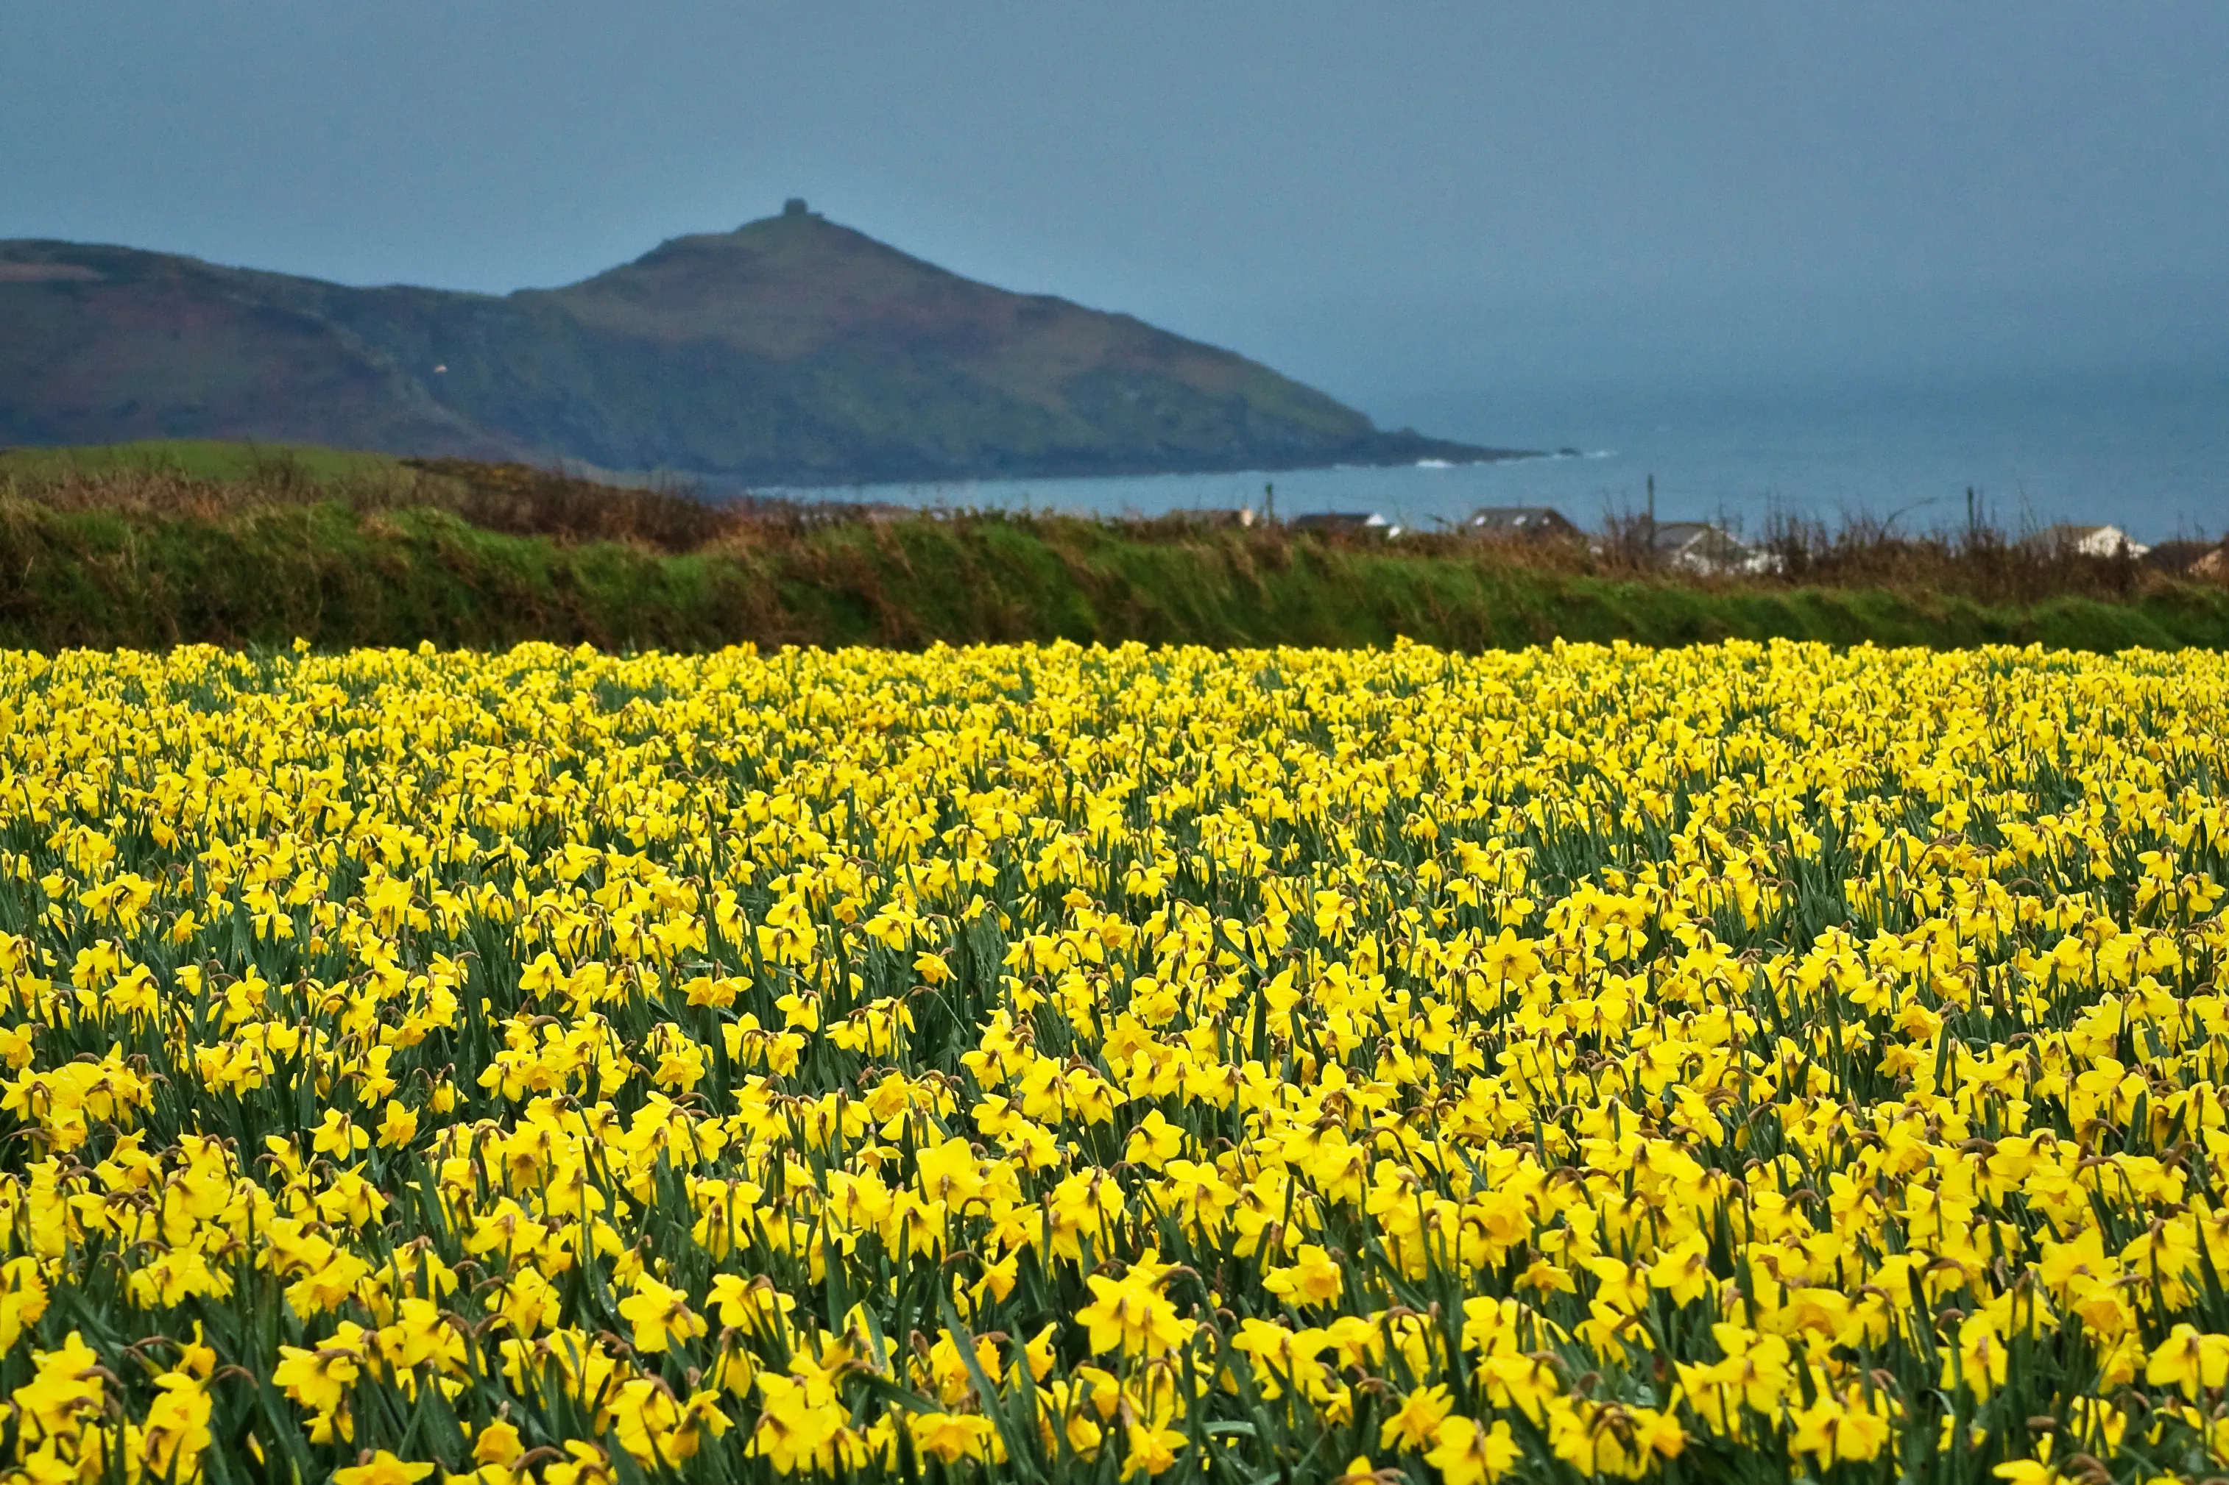
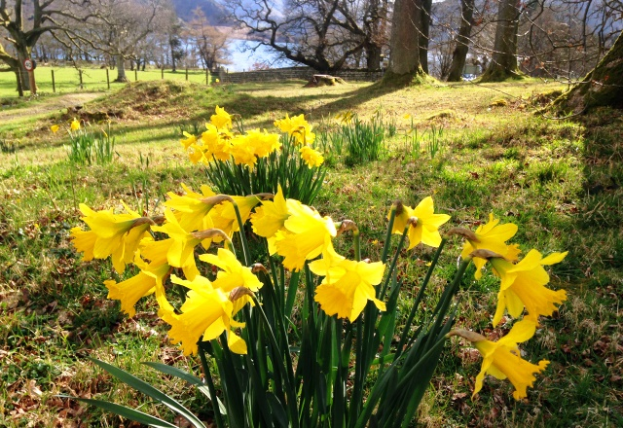
daffodils

Slide 13
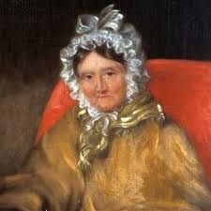
Excerpt from Dorothy Wordsworth's “Grasmere Journal”, 15 April 1802
It was a threatening misty morning—but mild. […] When we were in the woods beyond Gowbarrow park we saw a few daffodils close to the water side. We fancied that the lake had floated the seeds ashore and that the little colony had so sprung up. But as we went along there were more and yet more and at last under the boughs of the trees, we saw that there was a long belt of them along the shore […]. I never saw daffodils so beautiful they grew among the mossy stones about and about them, some rested their heads upon these stones as on a pillow for weariness and the rest tossed and reeled and danced and seemed as if they verily laughed with the wind that blew upon them over the lake, they looked so gay ever glancing ever changing.

Slide 14
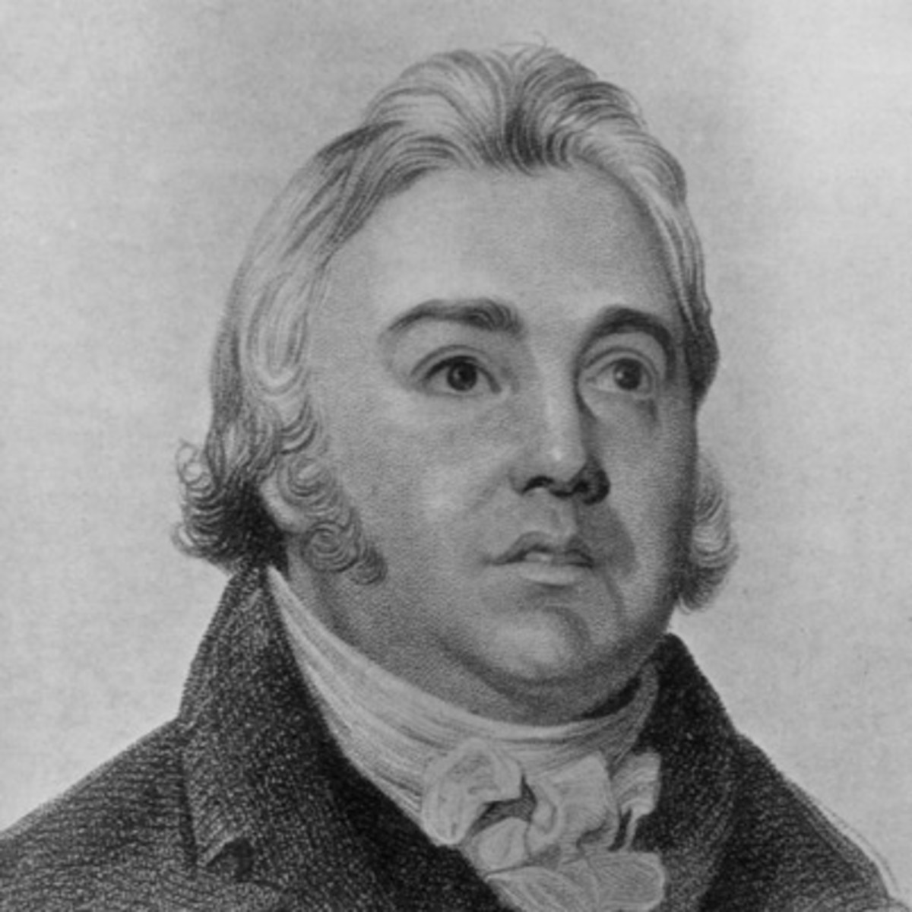
Samuel taylor coleridge (1772-1834)
Born in Devonshire
went to Cambridge, but never graduated.
influenced by French revolutionary ideals, but disappointment
collaboration with Wordsworth in 1797-1799
later a literary critic
The Rime of the Ancient Mariner (title!)

Slide 15
Wordsworth and coleridge
‘I wandered lonely as a cloud’ | The Rime of the Ancient Mariner (extract)
‘rustic’ and ‘humble’ life | supernatural theme
Ordinary events, praise of simple life ‘soil’ for ‘human passions’ | ‘willing suspension of disbelief’
‘The language … of these men has been adopted’ ‘purified indeed from what appear to be its real defects’ | Archaic language (title, spellings..)
Man and nature | Man and nature → but: two turning points

Slide 16
John KEATS (1795-1821)
Born in London in 1795
Early interest in mythology and Elizabethan poetry
The tendency to identify scenes and landscapes with subjective moods and emotions is rarely present in his poetry
Rome: Keats-Shelley House (Piazza di Spagna) and Cimitero Acattolico

Slide 17
KEATS ON POETRY
1st I think Poetry […] should strike the Reader as a wording of his own highest thoughts, and appear almost a Remembrance. […] – 2nd […] if Poetry comes not as naturally as the Leaves to a tree it had better not come at all.
(February 27, 1818)
As to the poetical Character itself [..] - it has no self - it is every thing and nothing - It has no character […]. What shocks the virtuous philosopher, delights the camelion Poet.
[…] A Poet is the most unpoetical of any thing in existence; because he has no Identity - he is continually in for - and filling some other Body - The Sun, the Moon, the Sea and Men and Women […] - the poet has none; no identity - he is certainly the most unpoetical of all God’s Creatures.
(October 27, 1818)

Slide 18
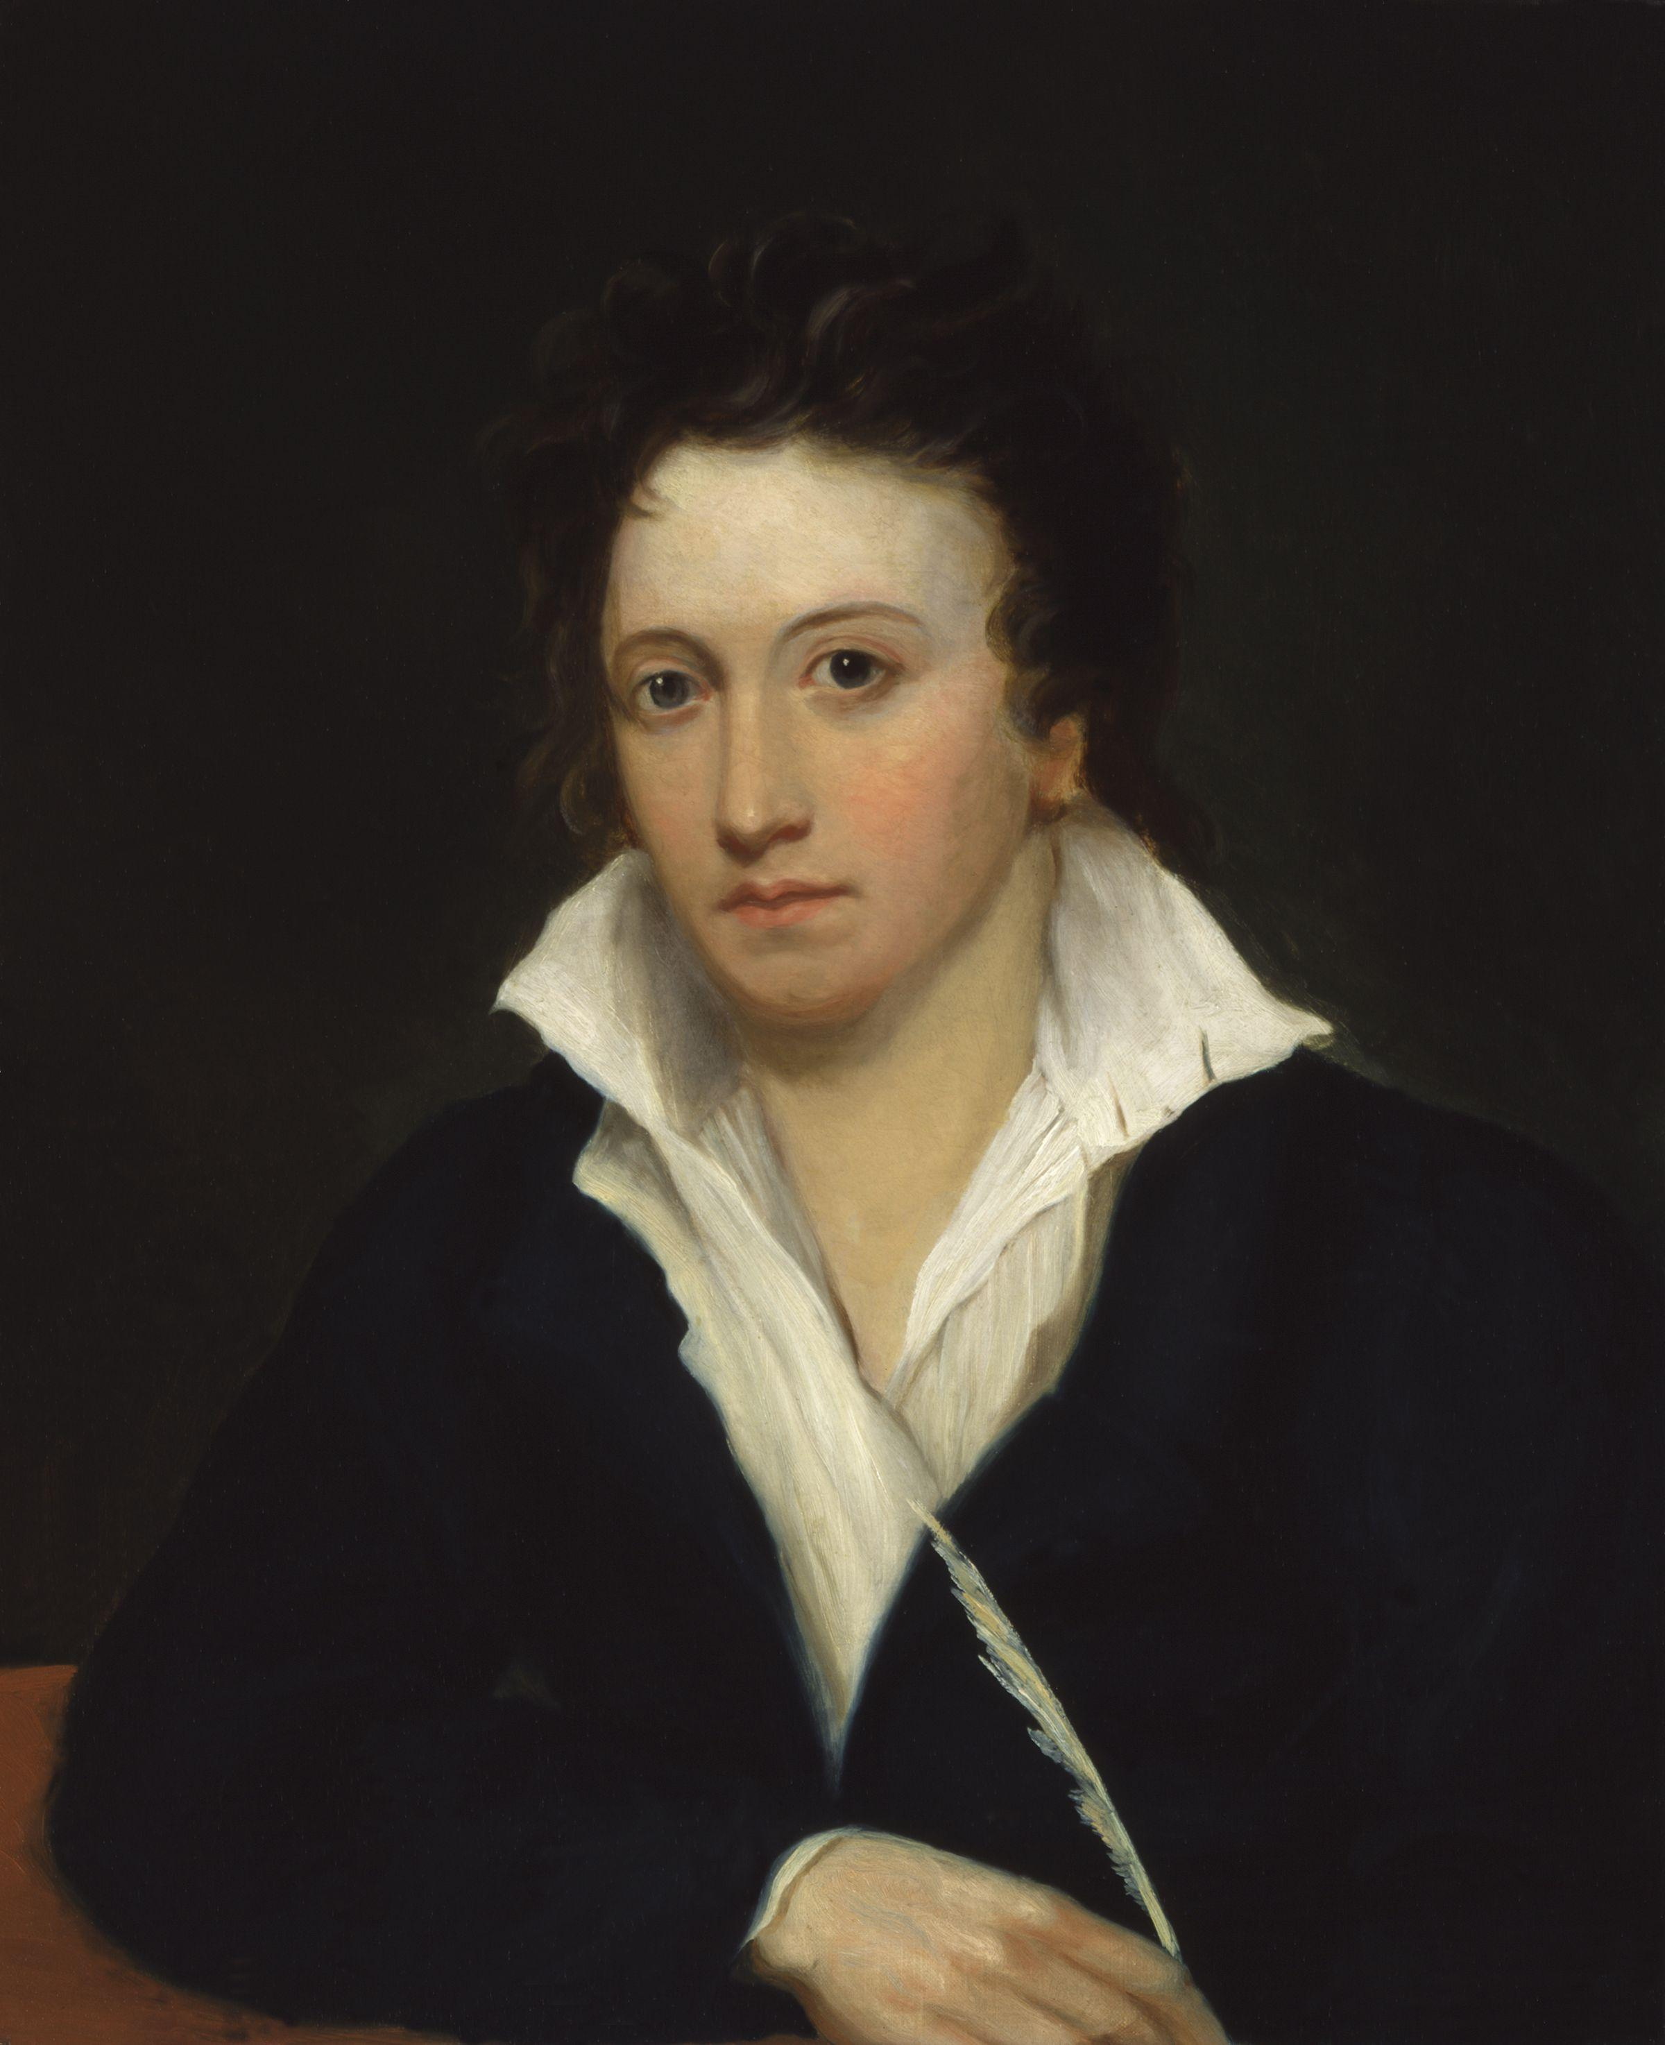
Percy BYSSHE SHELLEY (1792-1822)
well-off Sussex family (father MP and landowner)
1804: Eton College
1810: Oxford
1814 and 1816: Tour of the Continent with Mary Wollstonecraft Godwin
1818 – 1822 in Italy

Slide 19
SHELLEY, ‘A DEFENCE OF POETRY’ (1821)
A great Poem is a fountain for ever overflowing with the waters of wisdom and delight […]. Poetry is indeed something divine. It is at once the centre and circumference of knowledge; […] Poetry is the record of the best and happiest moments of the happiest and best minds. Poetry thus makes immortal all that is best and most beautiful in the world. […] Poets are the unacknowledged legislators of the world.

